Slide 1
Scala Collections & Performance Optimization
Dhara Ladani

Slide 2

📌 Outline
Overview of Scala Collections
Why use Scala Collections?
Comparison of Collections with example & When to use
Performance Optimization Techniques
Summary

Slide 3
Overview of Scala Collections
Scala Collections provide both immutable (default) and mutable versions.
Collections support functional and imperative programming styles.
Types of collections:
Immutable (Can’t modify): List, Vector, Map, Set, Tuple
Mutable (Can modify): ArrayBuffer, ListBuffer, Mutable.Map, Mutable.Set

Slide 4
Why use Scala Collections?
✅ Functional Programming: Immutable collections make code safer.
✅ Concise & Readable: Provides powerful higher-order functions (map, filter, reduce).
✅ Performance Optimization: Allows efficient memory usage & parallel processing.

Slide 5
Comparison of Collections & When to use
Collection | Best Use Case | Performance
List | Sequential operations | O(1) prepend, O(n) random access
Vector | Large immutable collections, fast access | O(log n)
Array | Fixed-size, fast indexed access | O(1)
ArrayBuffer | Fast mutable indexed access | O(1)
ListBuffer | Frequent modifications (append/prepend) | O(1) append
Set | Unique elements, fast lookups | O(1) lookup
Map | Key-value storage | O(1) lookup
Parallel Collections | Multi-core processing | Faster for large datasets

Slide 6
Performance Optimization Techniques
🔹 Use Vector instead of List for large data
✅ Why? Vector provides fast random access compared to List
🔹 Use view for Lazy Evaluation
val numbers = (1 to 100).view.map(_ * 2)
val result = numbers.take(10).toList // only computes first 10 elements
println(result) // Output: List(2, 4, 6, ..., 20)
✅ Why? Prevents unnecessary computations, saves memory.

Slide 7
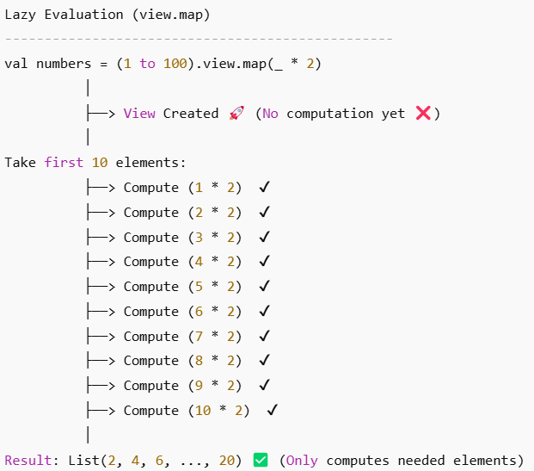
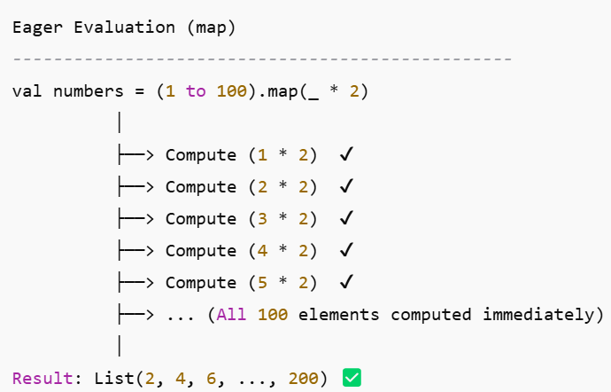

Slide 8
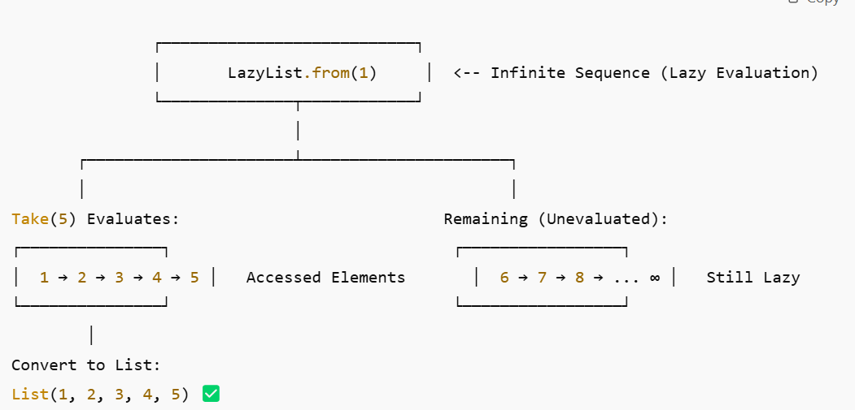
🔹 Use LazyList for infinite sequences
val stream = LazyList.from(1)
println(stream.take(5).toList) // Output: List(1, 2, 3, 4, 5)
✅ Why? Efficiently generates values only when needed.

Slide 9
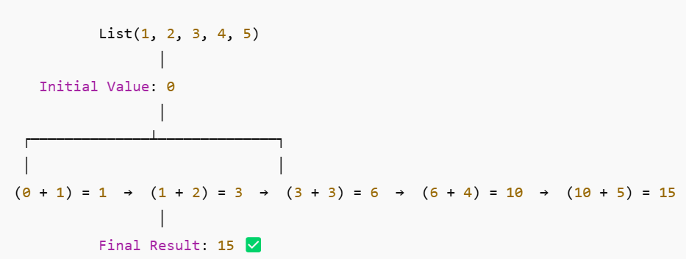
🔹 Use foldLeft for efficient Aggregation
val sum = (1 to 100).foldLeft(0)(_ + _)
println(sum) // Output: Sum of first 100 numbers
✅ Why? Avoids stack overflow issues from recursion.

Slide 10
Summary & Best Practices
Use immutable collections (Vector, List, Map) for safer code.
Prefer Vector over List for large datasets.
Use ArrayBuffer or ListBuffer for mutable collections.
Use view or LazyList to optimize memory usage.
Choose Set or Map for fast lookups instead of List.
🚀 Choosing the right collection improves performance & efficiency! 🚀

Slide 11

Thank you!

